Slide 1

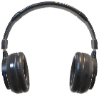
ARCHITECTURE DIAGRAM
WEBSOCKET
ANDROID APPLICATION
OPENCV
TENSORFLOW OBJECT DETECTION
GOOGLE TEXT TO SPEECH

